Slide 1
Blood Bank E-R Diagram
Presented By: Md. Foysal Mahmud
Roll: 14CSE028
Department of Computer Science & Engineering.
University of Barisal.

Slide 2
Entity-Relationship Model
Entity-Relationship (ER) Model is based on the notion of real-world entities and relationships among them.
E-R diagram has entities and attributes.
1. Entity is like class in C++.
2. Attributes is like object of a class.

Slide 3
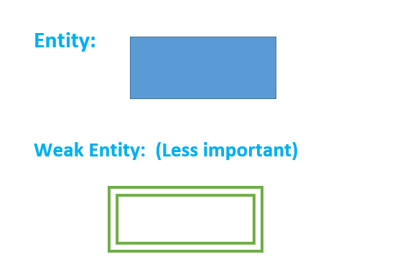

Slide 4
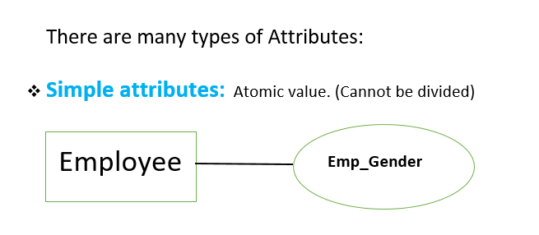

Slide 5
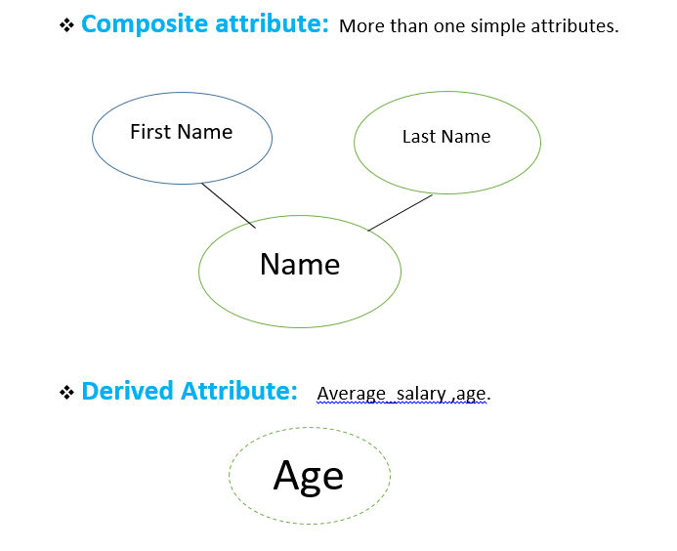

Slide 6
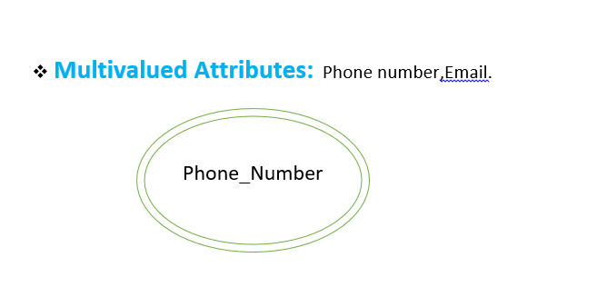

Slide 7
Blood Bank E-R diagram:
The entity are given below with its attributes
1.Doner ==={ Donar_id(primary), Name(Composite), Age(Derived),Address, PhoneNumber(Multivalued) }
2. Blood=== { Blood_Type,Code(primary),Cost. }
3. Receptionist=== { Emp_id(primary), Name(Composite), Address,PhoneNumber(Multivalued) }

Slide 8
4. Blood Bank=== {Blood_number(primary), Blood_type, Orders,Issues}
5. Blood Bank Manager== { Emp_id(primary), Name, Phone_number(Multivalued), Address) }
6. Hospital== { Hospital_name, Phone_number ,Location}

Slide 9
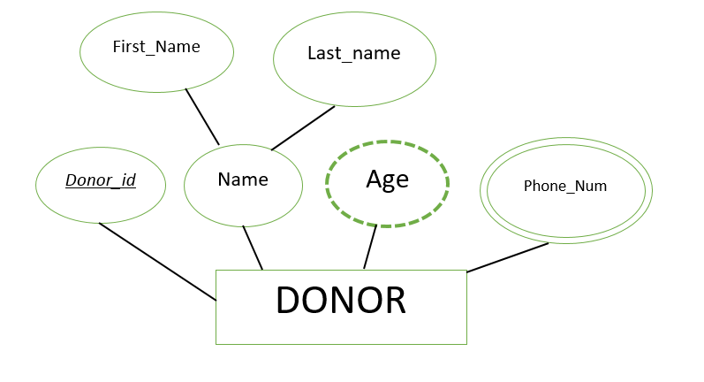
Donor Entities with Attributes:

Slide 10
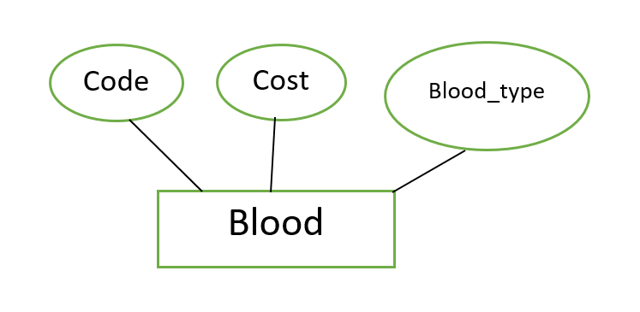
Blood Entities with Attributes:

Slide 11
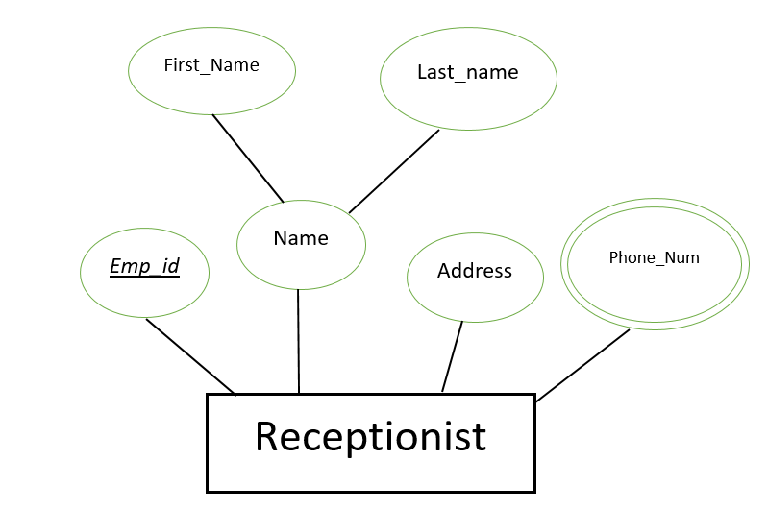
Receptionist Entities with Attributes:

Slide 12
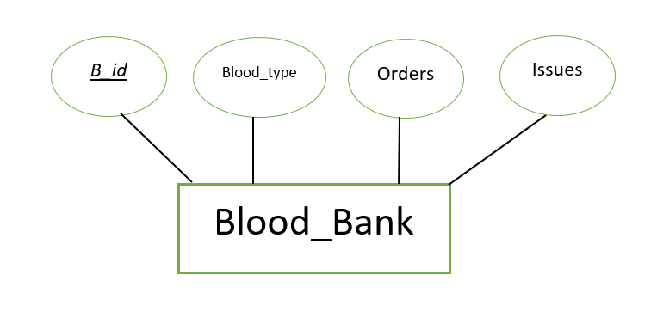
Blood Bank Entities with Attributes:

Slide 13
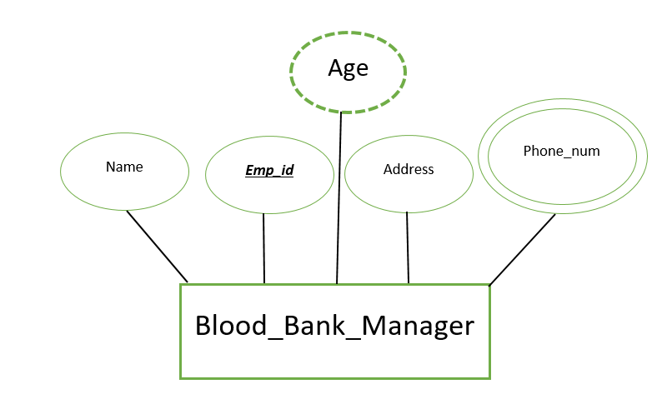
Blood Bank manager Entities with Attributes:

Slide 14
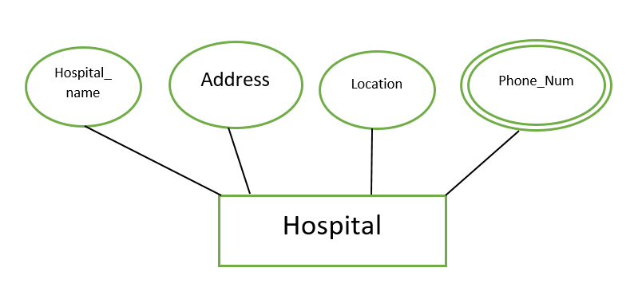
Hospital Entities with Attributes:

Slide 15
Relationship
Donor---> [Donate] ---> Blood ( 1 to N)
Donor---> [Registers]---> Receptionist (N to 1)
Receptionist---> [Works] ---> Blood Bank (1 to 1)
Blood---> [Store] ---> Blood Bank (N to 1)
Blood Bank--->[Manages] --->Blood Bank Manager (1 to 1)
Hospital ---> [Orders] ---> Blood Bank (M to N)

Slide 16
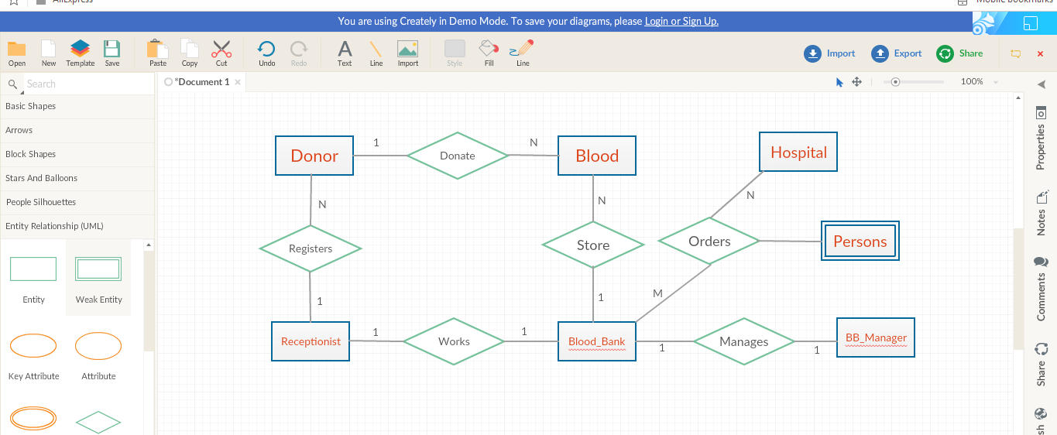
E-R Diagram:

Slide 17


